Slide 1

IEEE KiCAD Workshop
Learn how to design your own PCBs!
Notes:
Please introduce yourself:
Name
Major
What you hope to take away from this workshop

Slide 2
What is KiCAD?
KiCAD is a suite of tools to help you design circuits and printed circuit boards (PCBs)
Open source and with a large hobbyist userbase
Creating schematics, PCBs, and Gerber files

Slide 3
Getting Started
To get started, visit https://www.kicad.org/download/ and select your platform
If you don’t have a computer, just follow along with me for the live demonstration

Slide 4
General Workflow
Schematic
Footprints
PCB Layout
PCB Routing
Export to Gerber
Notes:
Creating a New Project
You start by creating a new project, which keeps all the necessary files organized.
Designing the Schematic
The schematic is a visual representation of your circuit, where you place components (resistors, capacitors, chips, etc.) and connect them with virtual wires.
This step focuses on functionality—making sure all components are correctly linked.
Assigning Physical Components (Footprints)
Every component in your schematic needs a corresponding physical version (footprint) that will be placed on the circuit board.
Footprints define where pins go and how big the component is on the board.
Laying Out the PCB
Once the schematic is complete, you transfer it to the PCB editor.
Here, you arrange the physical components on the board and connect them using copper traces, which replace the virtual wires from the schematic.
You also define the board’s shape and add features like mounting holes.
Checking for Errors
Before manufacturing, you run checks to catch any issues—like missing connections or components that overlap.
Exporting for Manufacturing
Once the board is finalized, you generate files (Gerber files) that a manufacturer can use to produce your circuit board.

Slide 5




KiCad Main Interface Overview
Eschema for schematic design
Pcbnew for PCB layout
Gerbview for viewing Gerber files
Additional tools: Bitmap2Component, PCB Calculator, Footprint Editor
Notes:
Eeschema: Schematic Editing Tool
Purpose: Eeschema is where the design process starts. Here, you create the electronic schematic by placing symbols that represent the various components in your circuit. These symbols are then interconnected with lines to illustrate the electrical connections between components. Eeschema allows for hierarchical design, making it easier to manage complex circuits by breaking them down into sub-circuits. It also checks for schematic errors, such as unconnected pins or conflicting connections.
Pcbnew: PCB Layout Editor
Purpose: Once the schematic is complete, Pcbnew takes over for the layout phase. It translates the schematic into a physical board layout, where you place component footprints and route copper traces to make the electrical connections real. Pcbnew supports multi-layer PCBs, offering extensive control over trace width, spacing, and via placement, critical for ensuring good electrical performance and manufacturability. It also includes tools for automatic and manual routing, as well as for checking design rules (DRC) to ensure compliance with manufacturing capabilities.
Gerbview: Gerber File Viewer
Purpose: Gerbview is used to inspect Gerber files, which are the standard format for PCB fabrication data. Once your PCB design is complete, you generate these files to send to a manufacturer. Gerbview allows you to review the layers of your board as they will appear to the manufacturer, helping you catch any potential issues before production. It supports viewing multiple layers simultaneously and can also be used to inspect drill files and board outlines.
Bitmap2Component: Creating Footprint from Bitmap Images
Purpose: Bitmap2Component is a utility tool within KiCad that converts bitmap images into footprints or silkscreen artwork for your PCB. This tool is particularly useful for adding logos, complex graphics, or text in specific fonts to your PCB design, enhancing its appearance or branding.
PCB Calculator: Utility for Common PCB Parameters
Purpose: The PCB Calculator offers a suite of tools for calculating important PCB design parameters. These include track width for current capacity, differential pair spacing for impedance control, and via dimensions for layer transitions. It's a valuable resource for ensuring your design meets the necessary electrical and thermal performance requirements.
Footprint Editor: Custom Footprint Creation
Purpose: While KiCad includes a vast library of component footprints, sometimes you'll need a footprint that's not available or requires customization. The Footprint Editor allows you to create or modify footprints to meet your specific needs. This is essential for accommodating unusual components or for optimizing footprint designs for better manufacturability or performance.
These tools work together seamlessly within KiCad, offering a complete suite for designing PCBs from concept to production. Understanding the purpose and capabilities of each tool is crucial for efficiently navigating the PCB design process.

Slide 6
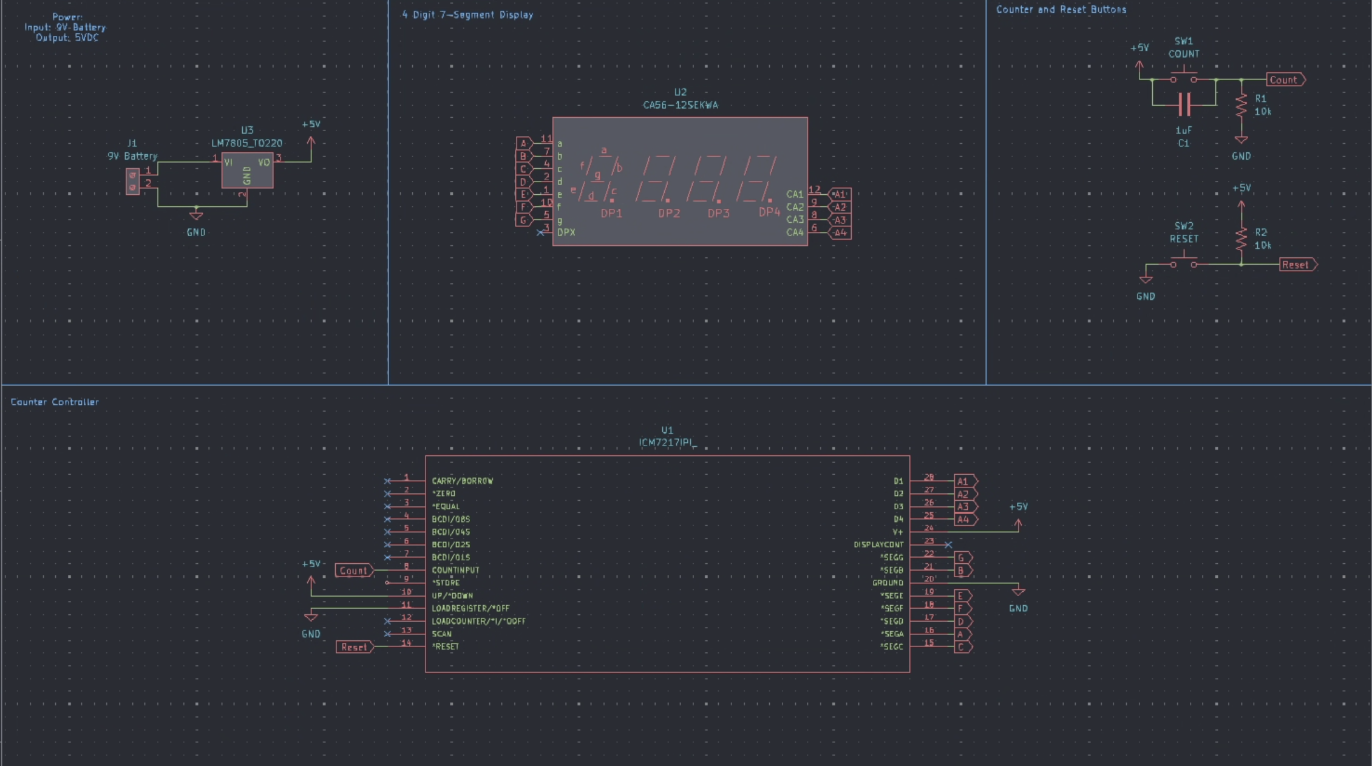
Digital Counter Circuit

Slide 7
Importing Components in KiCAD
Import new components when they don’t exist in KiCAD’s default library
Most parts suppliers (Digikey, Mouser, etc.) provide free downloads of the required library files

Slide 8
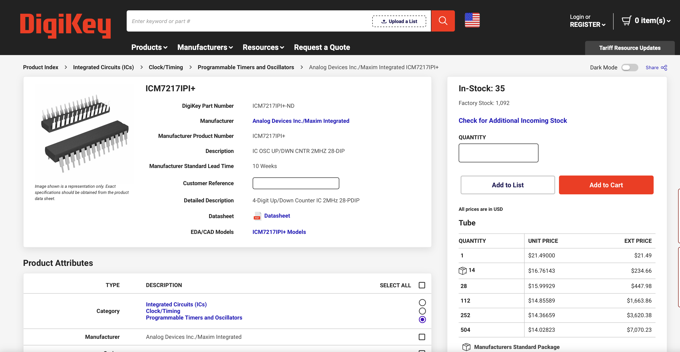
Download
ICM7217IPI+

Slide 9
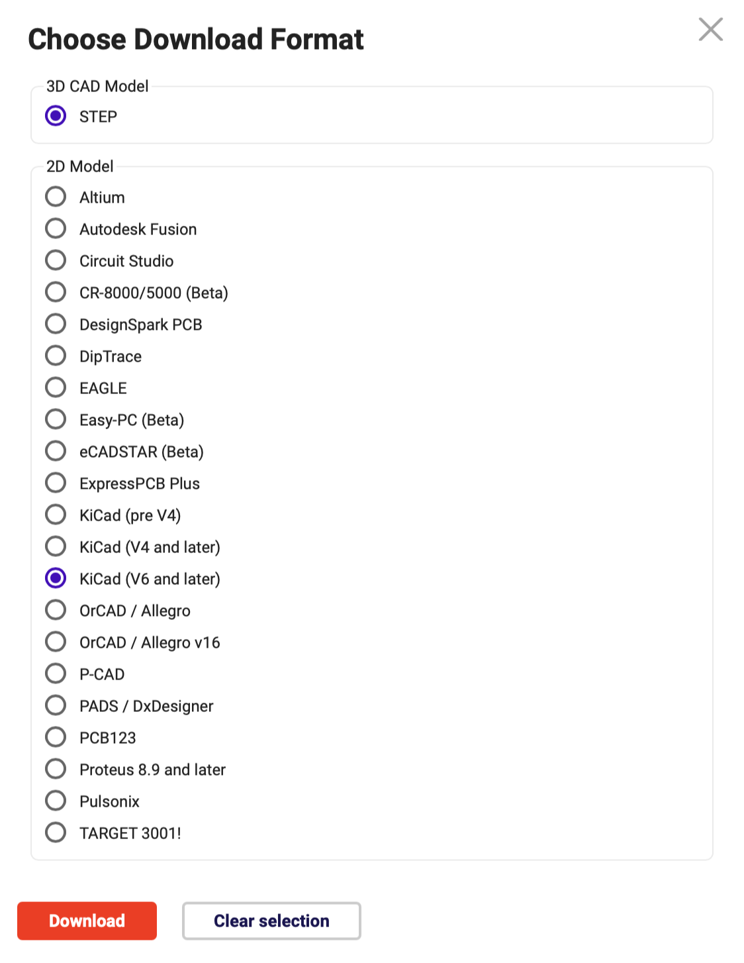

Download cont.
Find this button
Then select KiCAD (v6 and later), and
select STEP at the top
Press download

Slide 10

Importing to KiCAD
Select the icon
File > Add library > Project and navigate to your downloaded file
Tip: To stay organized, move the library files to your project’s folder

Slide 11
Build the Schematic

Slide 12

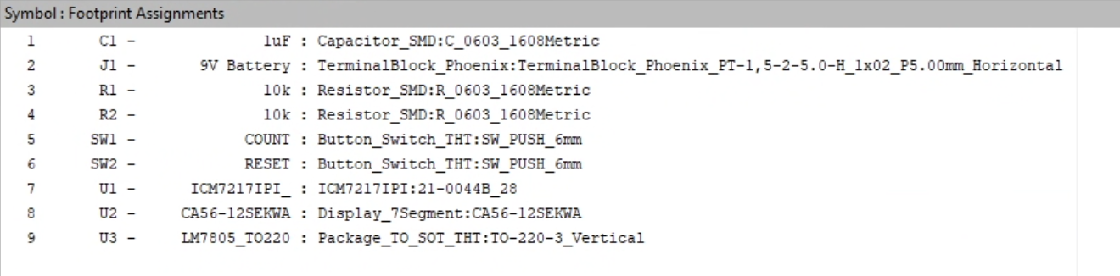
Footprints
    Use the button to open the footprint assigner
    Footprints should follow as listed below

Slide 13


PCB Time
Use the button to open your PCB file (might take a second)
Press the button and click “Update PCB” to add the footprints from the schematic

Slide 14
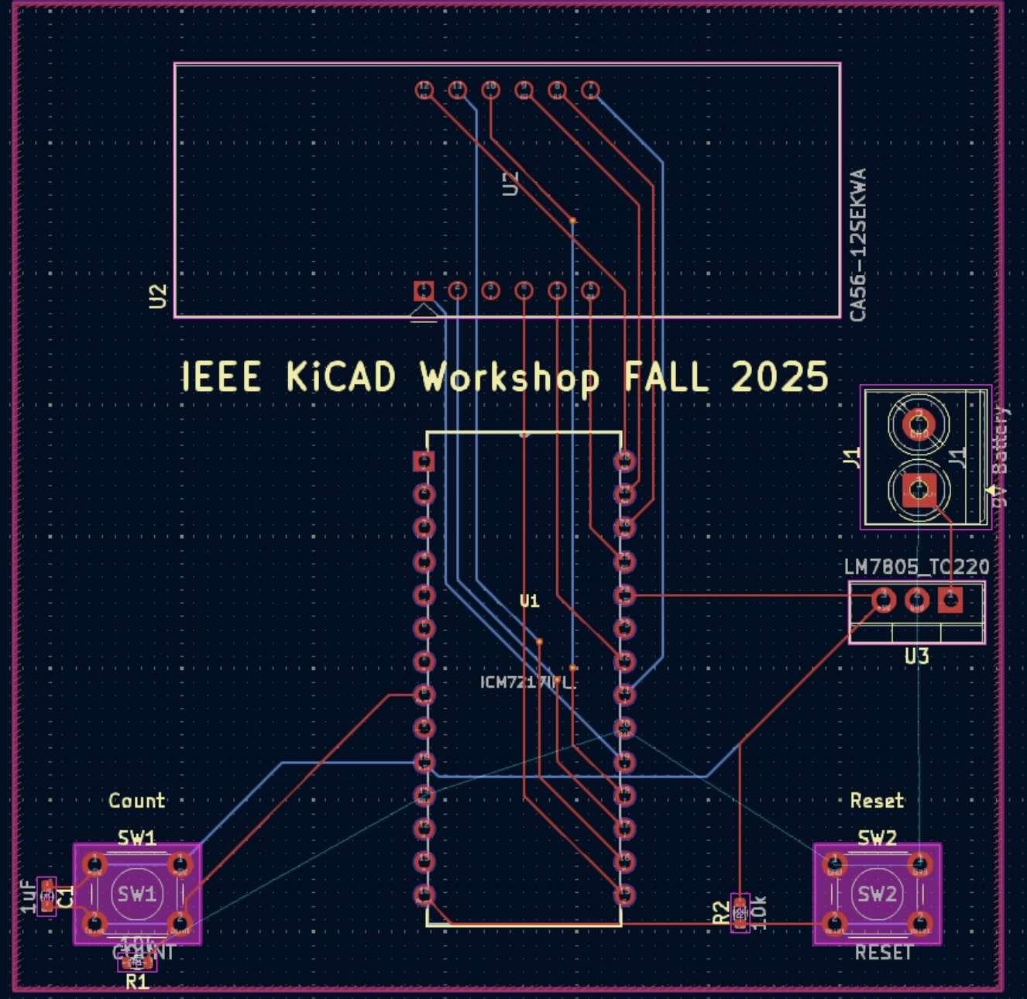
PCB Layout

